Slide 1
Cloud Computing
Dr. Md. Nasim Adnan

Slide 2
Moving Applications to the Cloud
The process for determining whether, what, and when to move your applications to the cloud involves an analysis of what critical features of the application need to be supported.
After those critical features are understood, you can determine the features supported by your particular cloud service provider to see whether the cloud can support the application’s critical features.
Factors such as access to data, latencies, data security, and so on often limit what applications are good candidates for porting.

Slide 3
When you move an application to the cloud, you must use the APIs of your particular cloud service provider. There are APIs for each of the types of cloud services: infrastructure, software services, and applications.
These APIs are generally not interoperable. So although the situation may change in the future, an application developer must make an informed choice to select the vendor that both best suits his needs and allows him to have greater flexibility.

Slide 4
When you deploy an application to the cloud, you start with the advantages and disadvantages of a distributed system that is the Internet and add to that mix the fundamental characteristics that clouds offer.
In the cloud, your applications must account for system abstraction and a whole new set of application and system APIs, LAN/WAN latencies, and other factors that are specific to one cloud platform or another. In theory, any application can run either completely or partially in the cloud.
The question a developer needs to ask is whether his application’s function is best served by cloud or local deployment. That answer depends upon the attributes of the application that the developer is trying to preserve or enhance, and how locating those services in the cloud impacts those attributes.

Slide 5
The location of an application or service plays a fundamental role in how the application must be written. An application or process that runs on a desktop or server is executed coherently, as a unit, under the control of an integrated program. An action triggers a program call, code executes, and a result is returned and may be acted upon.
Taken as a unit, “Request => Process => Response” is an atomic transaction. Because the transaction is executing locally within the purview of a monolithic application, the process is stateful and transaction is consistent.
That is, the condition of the transaction is always known and the result is always accounted for. A coherent transaction either succeeds and is enacted, or fails and is rolled back.

Slide 6
An application that runs as a service on the Internet has a client portion that makes a request and a server portion that responds to that request.
The request has been decoupled from the response because the transaction is executing in two or more places. In a distributed system, the transaction is stateless. In order to create a stateful system in a distributed architecture, a transaction manager or broker must be added so that the intermediary service can account for transactions and react accordingly when they succeed or fail.
When applications get moved to the cloud, they retain the features of a three-layered architecture, but now physical systems become virtualized systems. Virtual machines are not only stateless, but the place where program execution occurs is likely to be different every time the process runs. These fundamental properties must be accounted for in any cloud-based application.

Slide 7
Functionality Mapping
Some applications can be successfully ported to the cloud, while others suffer from the transition process.
Understanding whether your particular application can benefit from cloud deployment requires that you deconstruct your application’s functionality into its basic components and identify which functions are critical and can be supported by the cloud.
For example, any application that requires access to a data store quickly runs up against some of the limits that cloud computing imposes. Order transaction systems require that data in a database maintain the transactional integrity implied by the ACID model.

Slide 8
For many non-relational cloud storage systems, such as the Amazon Simple Storage Service (S3), the newly announced Google Storage for Developers, and the Windows Azure Storage Service, the ability of the system to maintain transactional integrity through record locking isn’t part of those systems.
These types of storage systems are secure and store large amounts of data, but they have very slow access to that data and do not support query and retrieval well. These limitations are why all these vendors offer alternative relational cloud database systems such as SQL Azure.

Slide 9
In the next Figure, an attribute tree is constructed for an order transaction system where the functionality is decomposed into different functional areas.
At the top are high-level attributes; some of these functions are essential to the operation of the application while others are not.
Drilling down on the data management attribute, the second level explores data access and then access methods.
A critical attribute for the application is the need to be able to access data when the client is both online and offline.

Slide 10
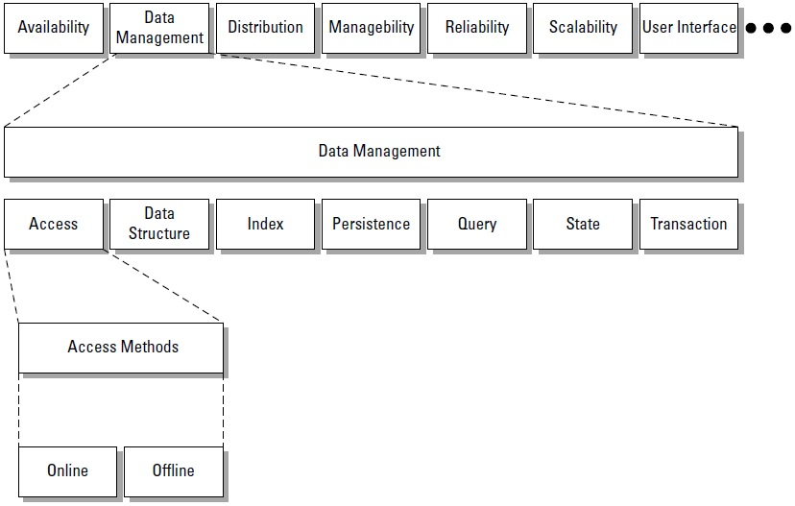

Slide 11
The choice to allow both online and offline data access determines the nature of your application’s interaction with both cloud and local data stores.
The decision to allow both online and local data access means that you must create a hybrid application with a cloud component and a local component. Till now, transactional parts of an application kept outside of cloud.
To support the application’s data access, you may also be faced with building a synchronization or replication feature, which adds more overhead to the application.

Slide 12
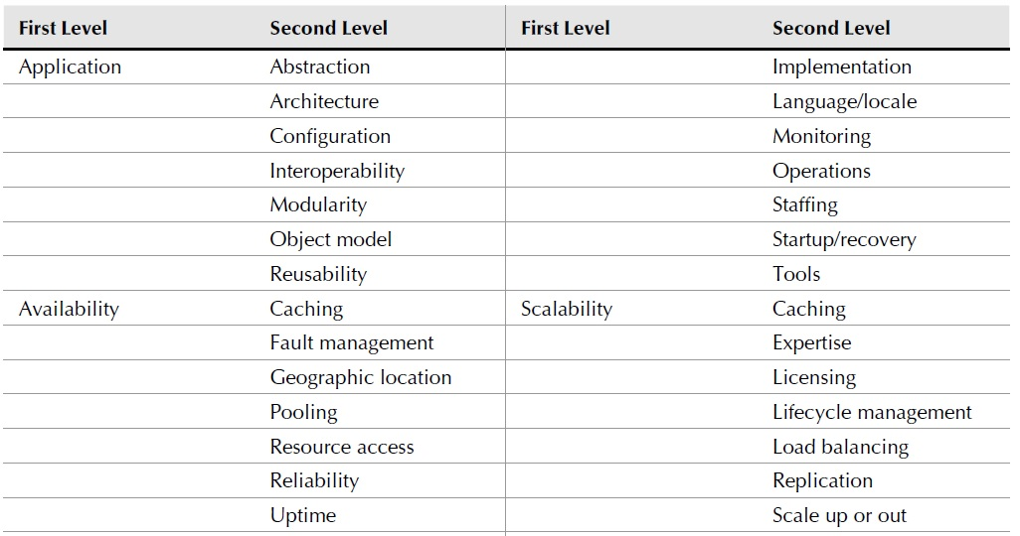
Application Attributes

Slide 13
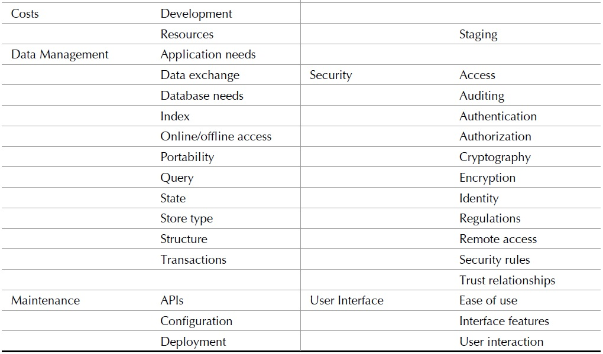
Application Attributes

Slide 14
Application Attributes
Applications that benefit from deployment to the cloud are those that meet these criteria:
Are not mission critical
Are not core business functions
Do not have sensitive data to protect
Tolerate high network latencies or low network bandwidth
Are based on industry standard technologies
Do not need to be customized
Are mature enough and understood well enough to be successfully ported to the cloud

Slide 15
Cloud Service Attributes
We want to match up application attributes to these key cloud service attributes:
Applications
Core services
Infrastructure
Platform features
Storage
At the current stage in its development, it is impracticable to match the needs of an application to a set of cloud service providers. Each provider has a unique solution, uses its own APIs, and provides unique services. Therefore, each cloud provider needs separate developer skills, and integration between clouds would be a major chaos.

Slide 16
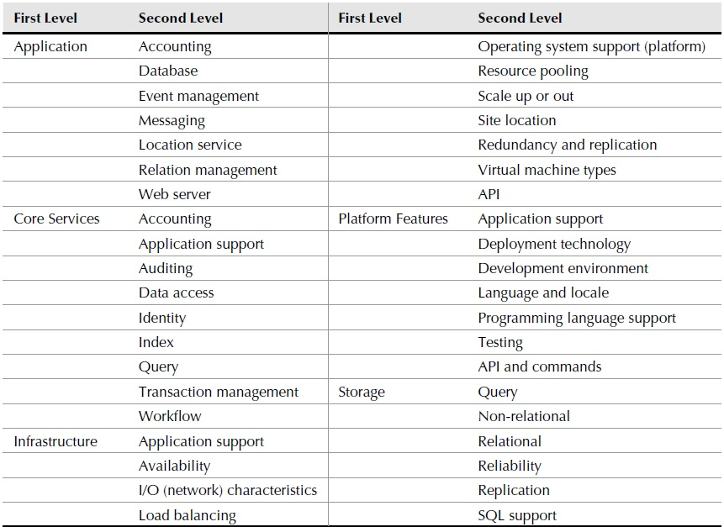

Slide 17
System Abstraction
The cloud turns physical systems into virtual systems. Organizations choose to deploy systems to the cloud entirely when they can recreate the essential part of their process and eliminate infrastructure.
As an example, consider a service that does medical imaging. In the past, this service created patient scans and then rendered the image on a local computer. After the image was rendered, it was posted to the hospital LAN and made available to the people who read the scans.
When the people reading the scans were outside the hospital, across the country, or around the world, cloud comes to play.

Slide 18
Cloud Bursting
Many cloud deployments are hybrid applications: Part of the application is on a local system, and part is in the cloud. Often, this is the first stop on the path for many organizations migrating their applications to the cloud.
There are many reasons why this is desirable, but one of the most common reasons is that the cloud can serve as excess capacity at times of high volume. This type of hybrid has been called cloud bursting.
In such system, there is a certain low level of background transactions occurring at any time. At certain times, events trigger high demand. If the system builds infrastructure to accommodate peak demand, then that infrastructure is wasted.

Slide 19
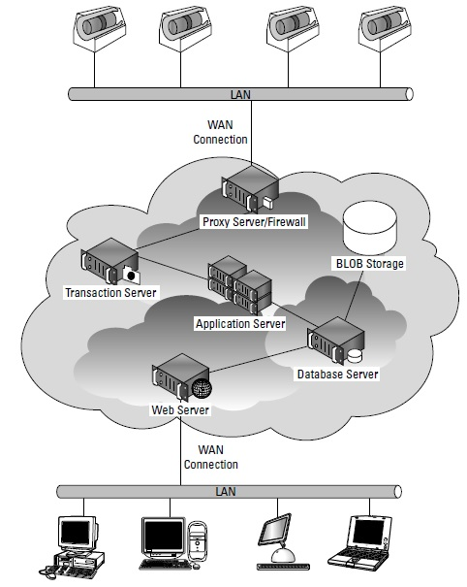
An application deployed entirely to the cloud

Slide 20
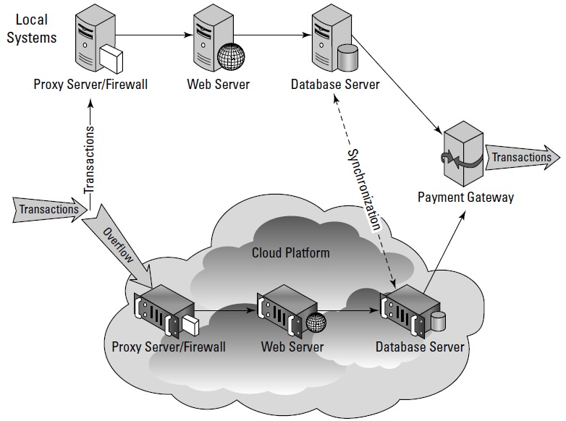
An example of cloud bursting

Slide 21
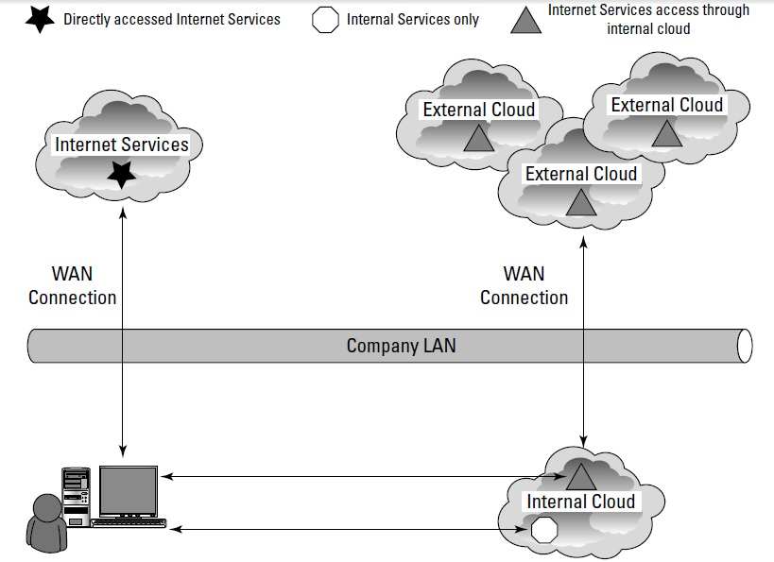
Cloud Everywhere

Slide 22
Applications and Cloud APIs
The nature of a cloud provider’s API will impact your ability to move an application to the cloud and affect the way many of your application features operate.
Cloud APIs are the Application Programming Interface to allow the exchange of information in and out of the cloud, request supported operations, and provide management and monitoring functions for applications running in the cloud.
The point is that the decision to move an application to the cloud rapidly funnels you into a specific solution that may result in vendor lock-in, depending upon the nature of your application, can be anywhere from very easy to nearly impossible to port to any other cloud technology.

